Slide 1
Customer Churn Prediction
PROJECT ON
RAHUL JANJIRALA

Slide 2
CRISP-ML(Q)
Cross-Industry Standard Process model for Machine Learning
1. Business Understanding
2 . Data Preparation
3 . Model Building
4 . Model Evaluation
5 . Model Deployment
6 . Monitoring and maintainance

Slide 3
Followed CRISP-ML(Q) Methodology
Problem Statement:
Build a predictive model to estimate the likelihood of customer churn for a telecommunication company. The model should consider factors such as customer demographics, usage patterns, billing history, and customer service interactions.
Business Understanding
Objective:
Predict the likelihood of customer churn.
Goals:
Reduce customer churn rate by identifying at-risk customers and implementing retention strategies.

Slide 4
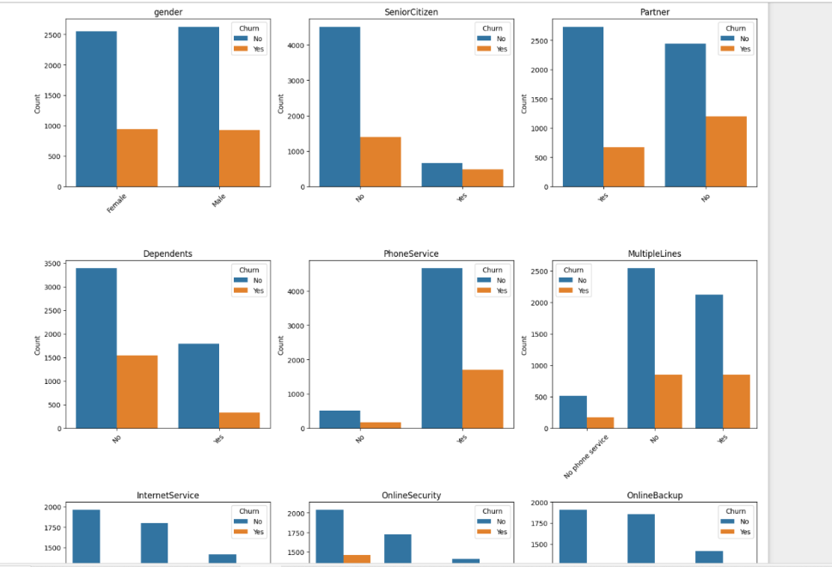
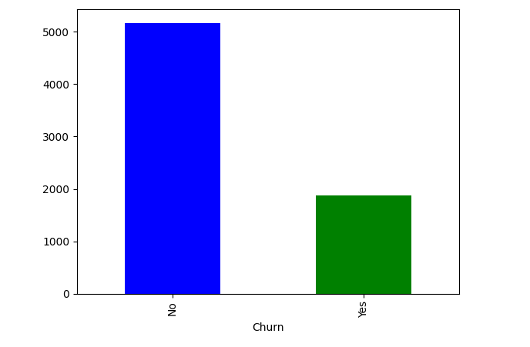
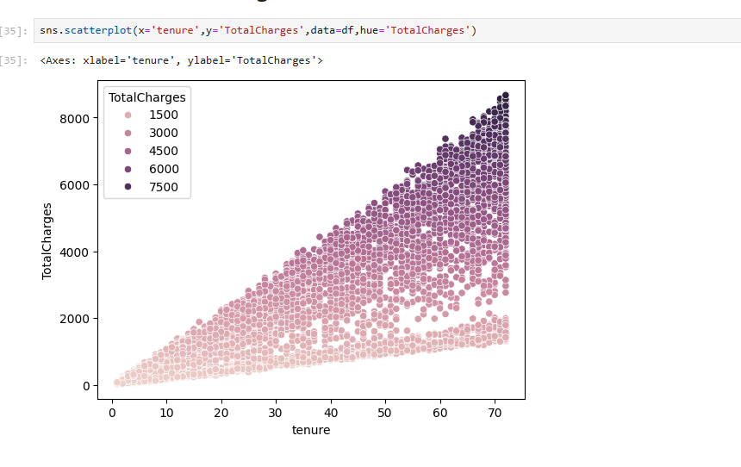
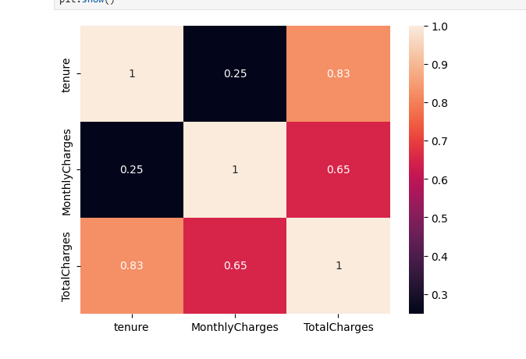
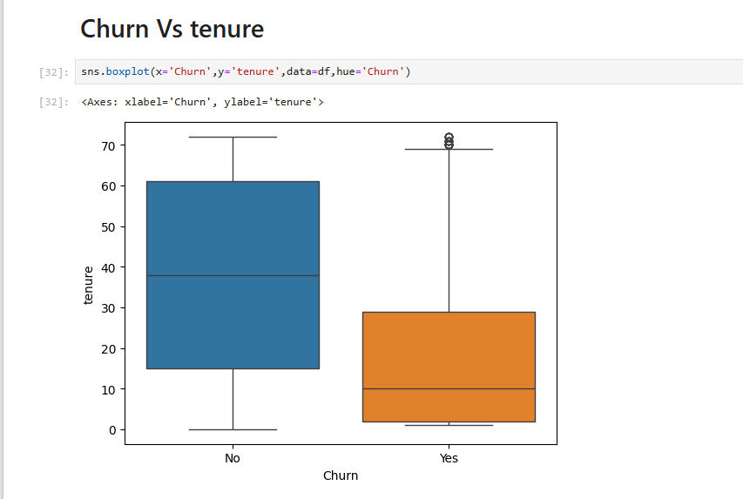
Some of the Exploratory Data Analysis

Slide 5
Data Preprocessing
To enhance the clarity and usability of your dataset, which initially comprised 7043 rows and 21 columns and seemed imbalanced and unclear, you employed data preprocessing techniques. This involved a series of steps aimed at cleaning, transforming, and organizing the data to make it more structured and understandable. Through these preprocessing techniques, you refined the dataset, making it more suitable for analysis, modeling, and interpretation.
DATA PREPROCESSING TECHNIQUES THAT I USED :
Missing Values - Discreatization
Type casting - Transformation
Outliers
Duplicates
Encoding/Dummy Variable Creation
Scaling

Slide 6
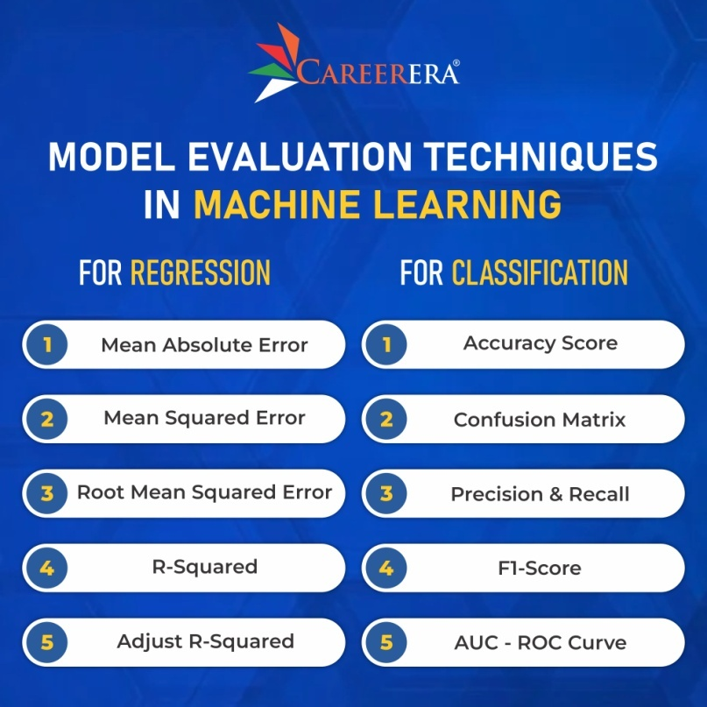
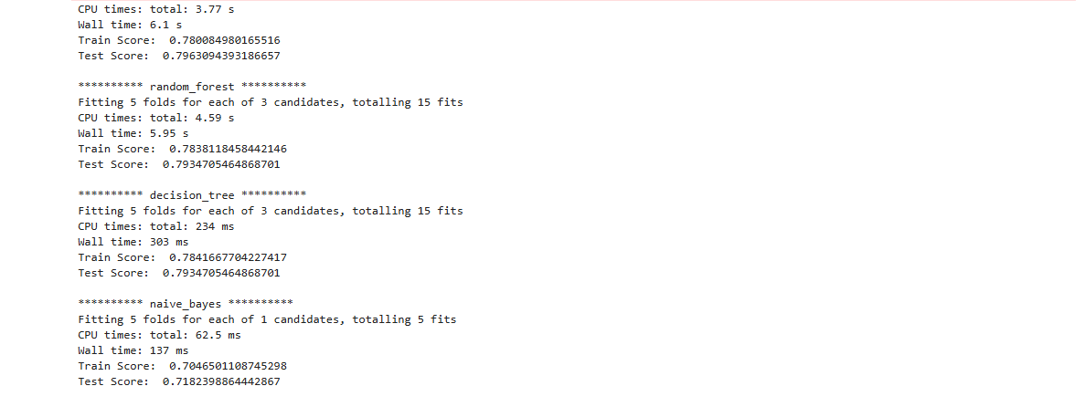
Model Evaluation
As my project is related to Classification
We can go classification metrics like Accuracy score , confusion , precision , recall , F1-score

Slide 7
Model Deployment
Hosting the application in the production so that end user can use our application to predict the unseen or future data.
Using Local based deployment frameworks I deployed using Stream lit ,we can also use Flask or Fast API .
Stream lit is an open-source Python library that simplifies the process of creating web applications for machine learning and data science projects. It allows developers to quickly build interactive and customizable web interfaces directly from their Python scripts, without the need for web development expertise.
Deployment: Stream lit provides built-in support for deploying web applications to various platforms, including Streamlit Sharing, Heroku, and AWS. This makes it easy to share your machine learning projects with colleagues, clients, or the wider community.

Slide 8
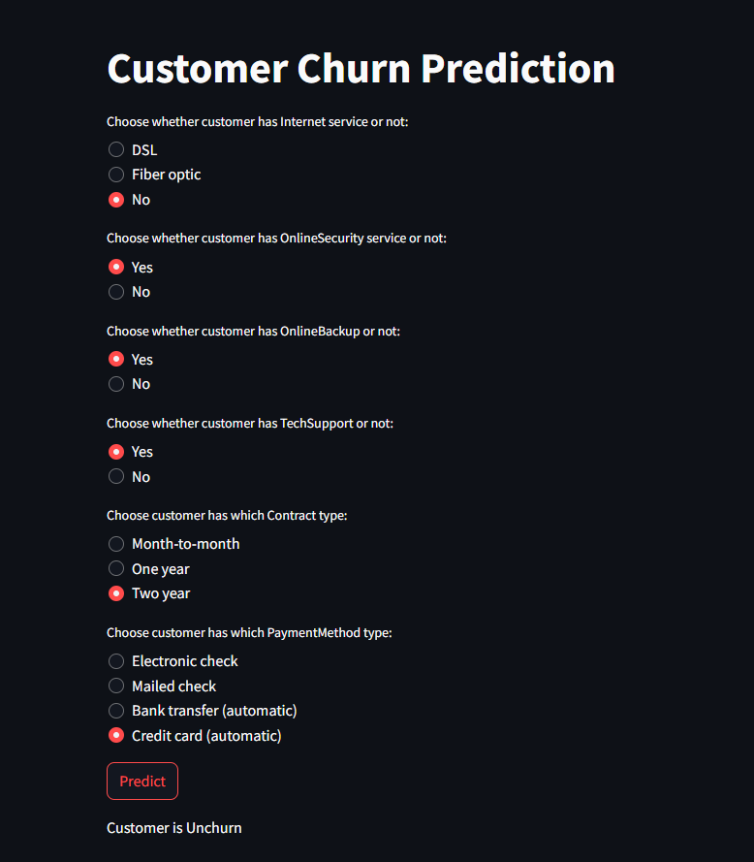

Slide 9
Conclusion
Project Summary:
This project aimed to predict customer churn for a telecommunication company using a machine learning approach. By leveraging customer demographics, usage patterns, billing history, and customer service interactions, we developed a predictive model to identify at-risk customers.
Achievements:
Successfully identified key features that influence customer churn.
Developed and trained multiple machine learning models, with XGBoost achieving the highest performance metrics.
Achieved significant accuracy and ROC-AUC scores, indicating the model's effectiveness in predicting churn.

Slide 10


